Slide 1


Slide 2

Republic Day 2016 at
Sankalp Centres

Slide 3
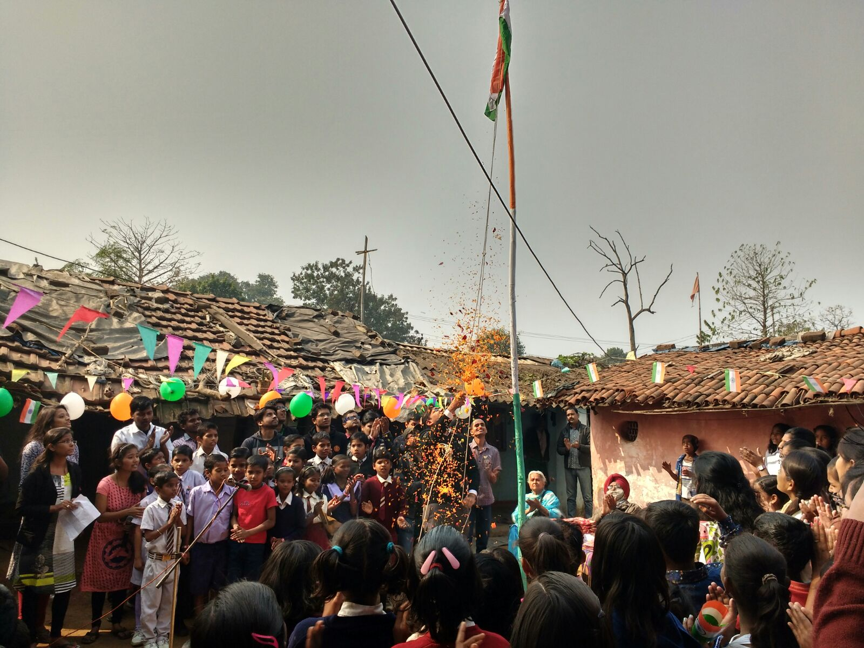
Where the mind is without fear
and
the head is held high........

Slide 4


Slide 5
Republic Day celebration
across
Sankalp Centres

Slide 6
Madhepura Centre
Gamharia
Bihar

Slide 7
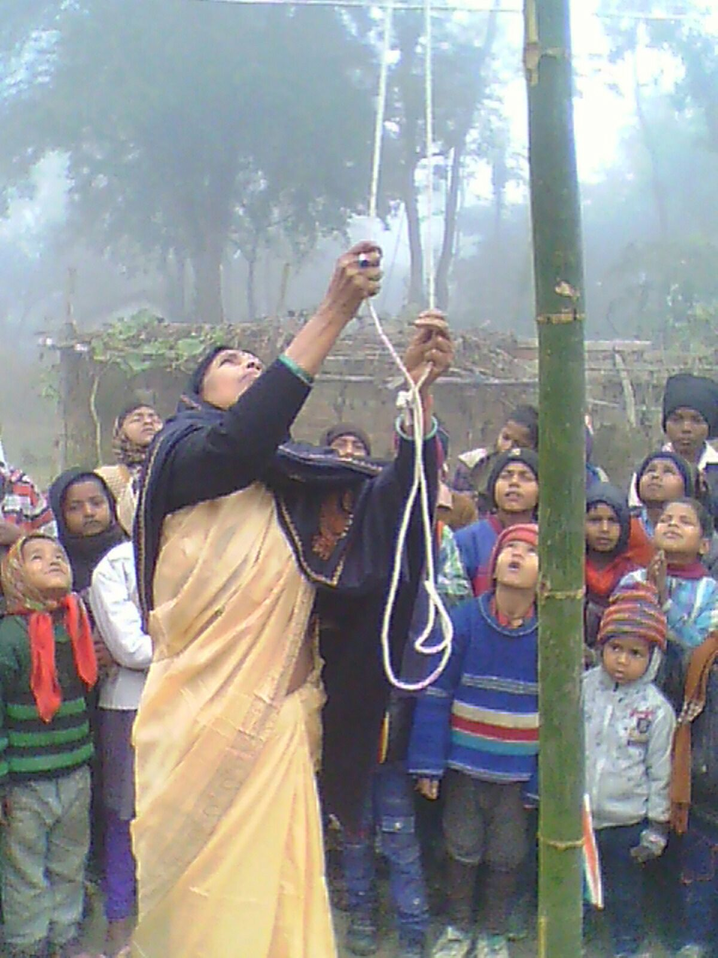
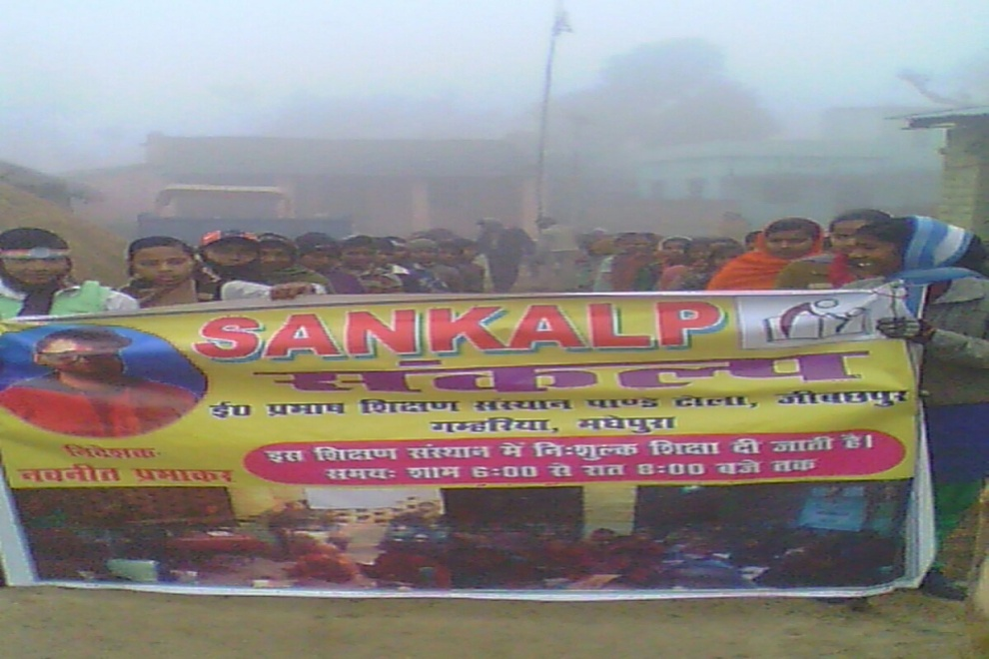
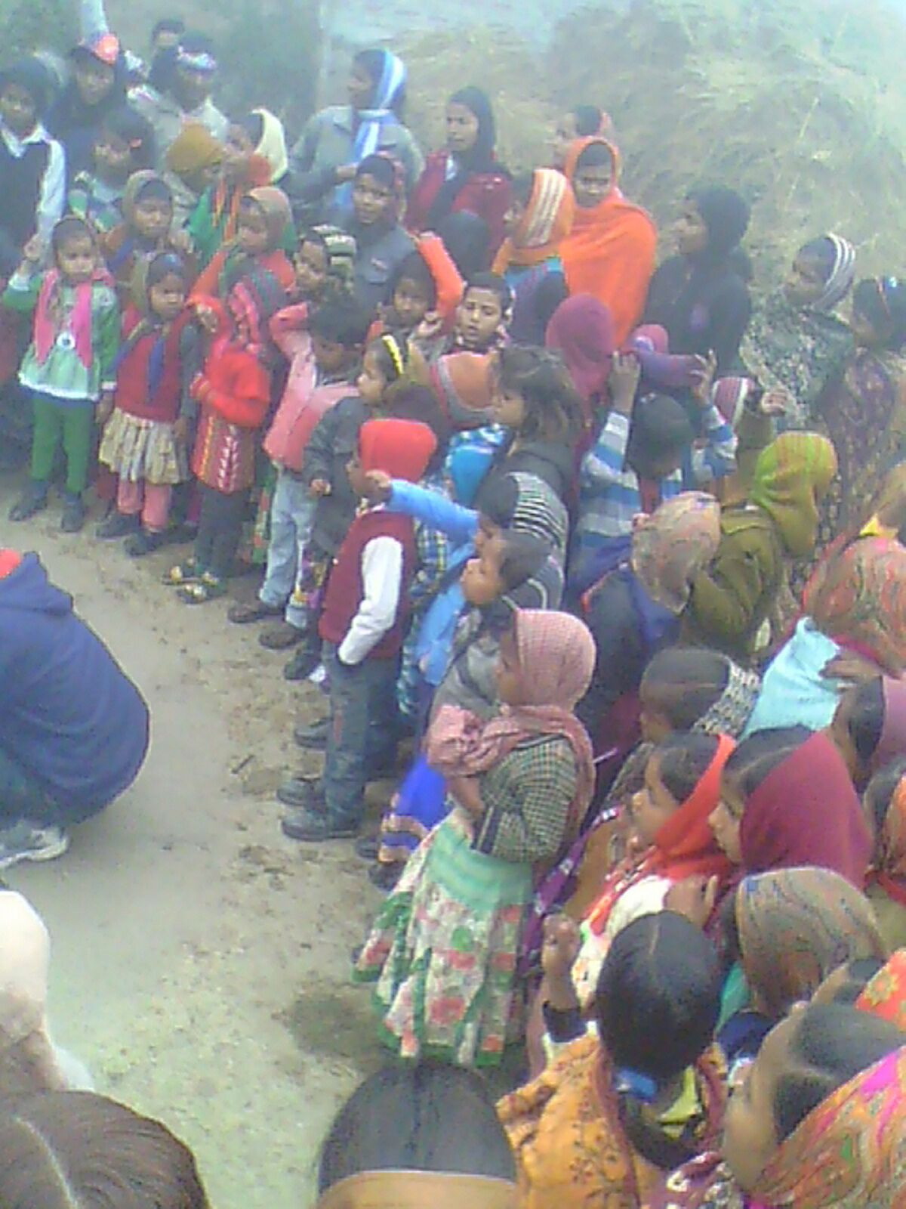

Slide 8
Dhanbad Centre
Kendua Block
Jharkhand

Slide 9
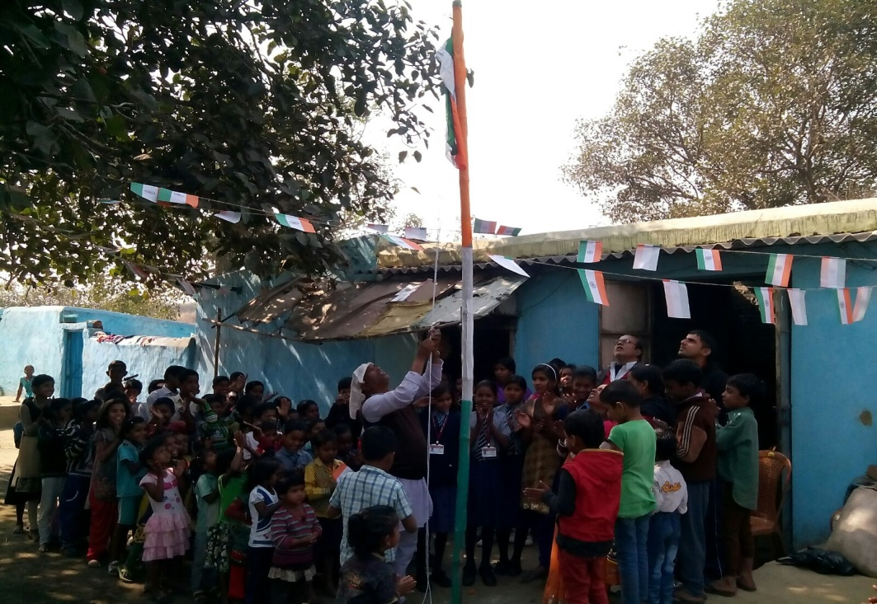
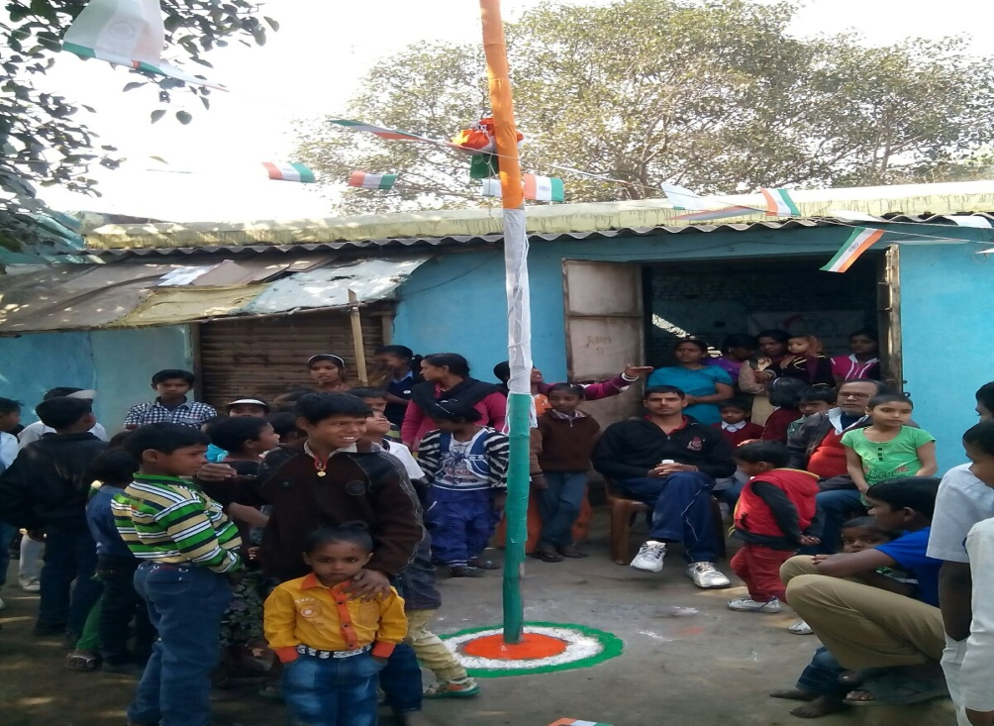
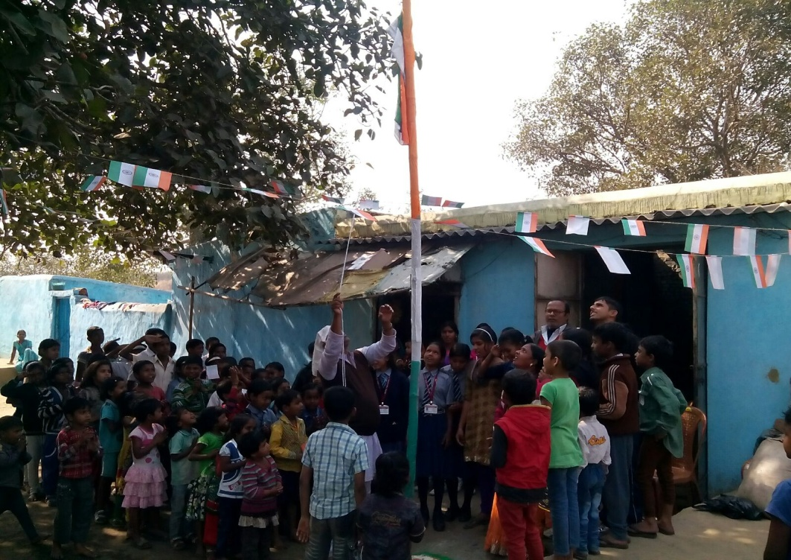
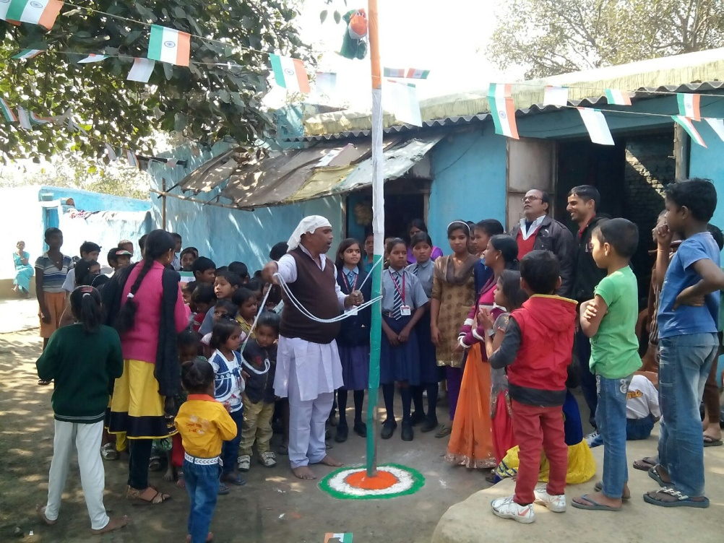

Slide 10
Adityapur Based Centres
Mohan Nagar, N.I.T., Imli Chauk & Aashiyana
Jharkhand

Slide 11
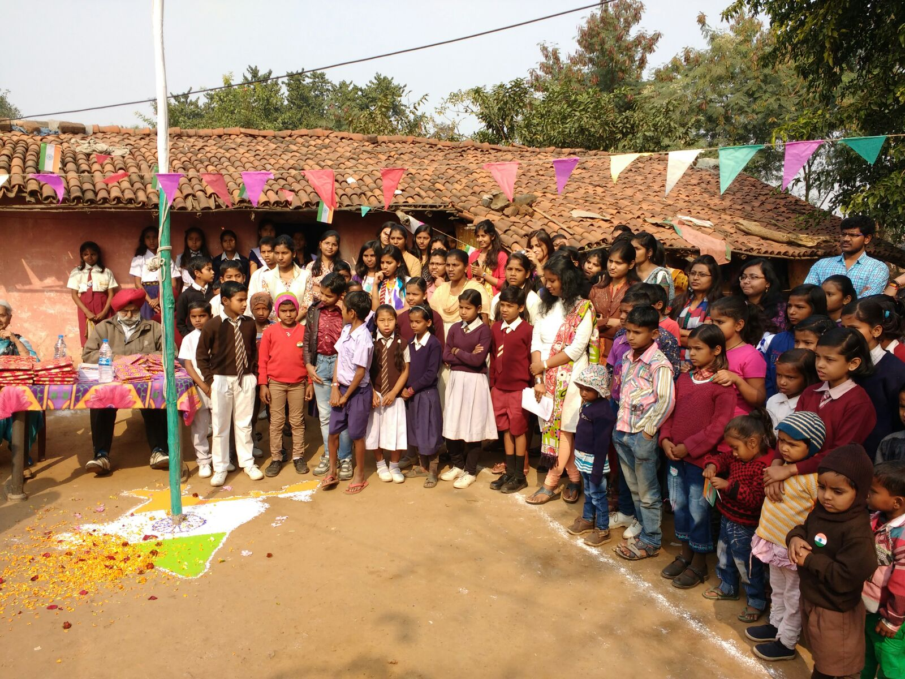

Slide 12
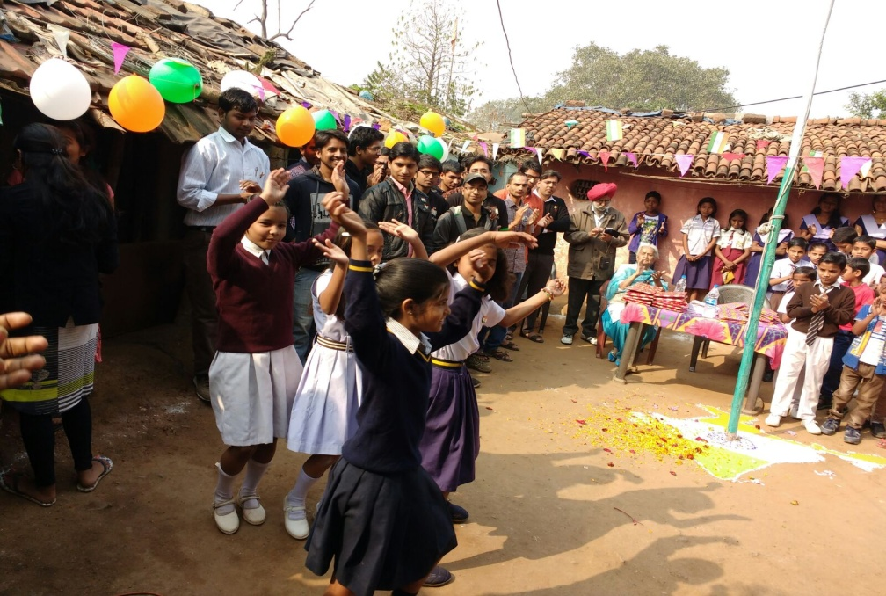
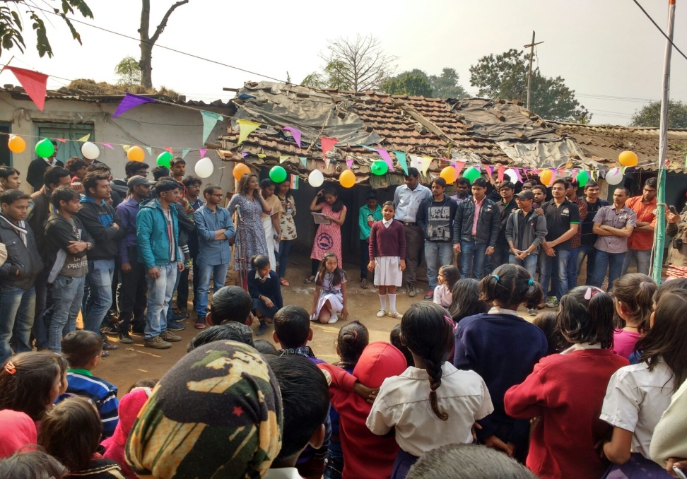
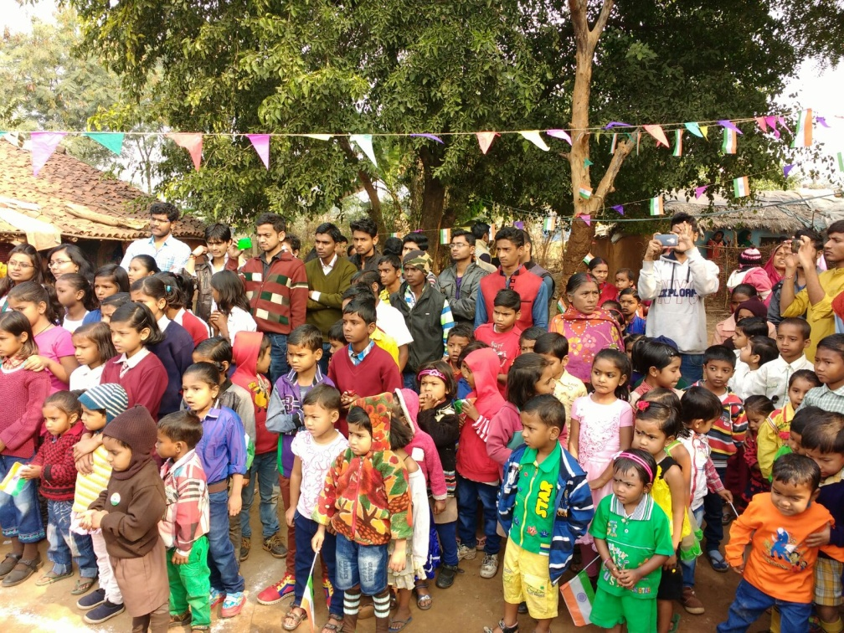
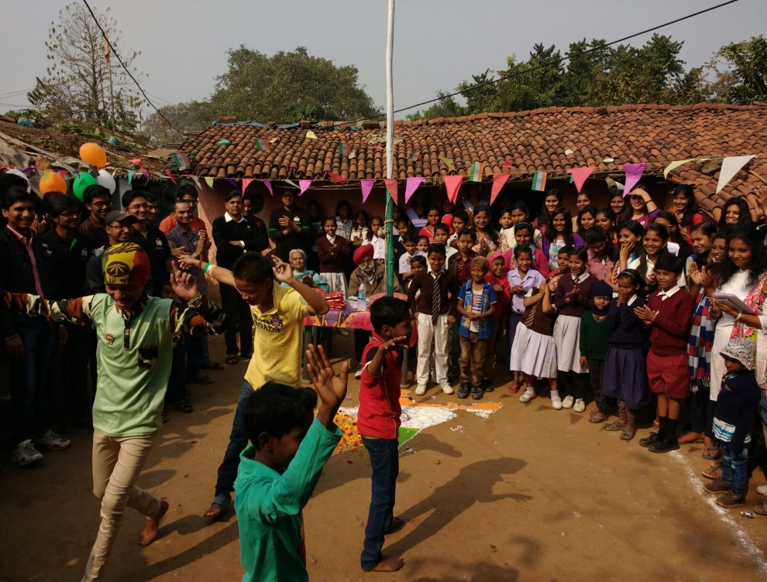

Slide 13
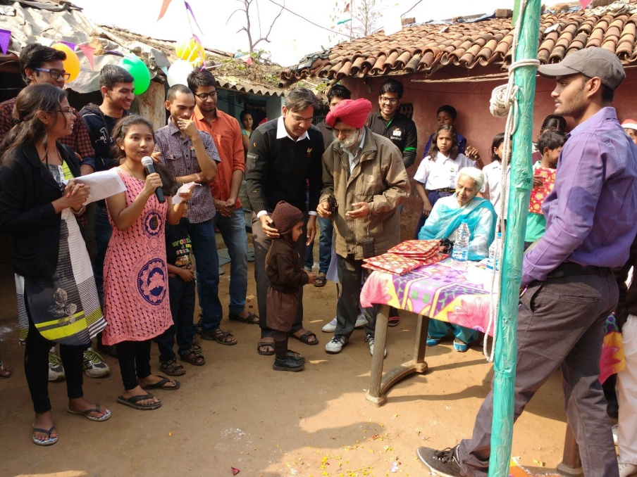
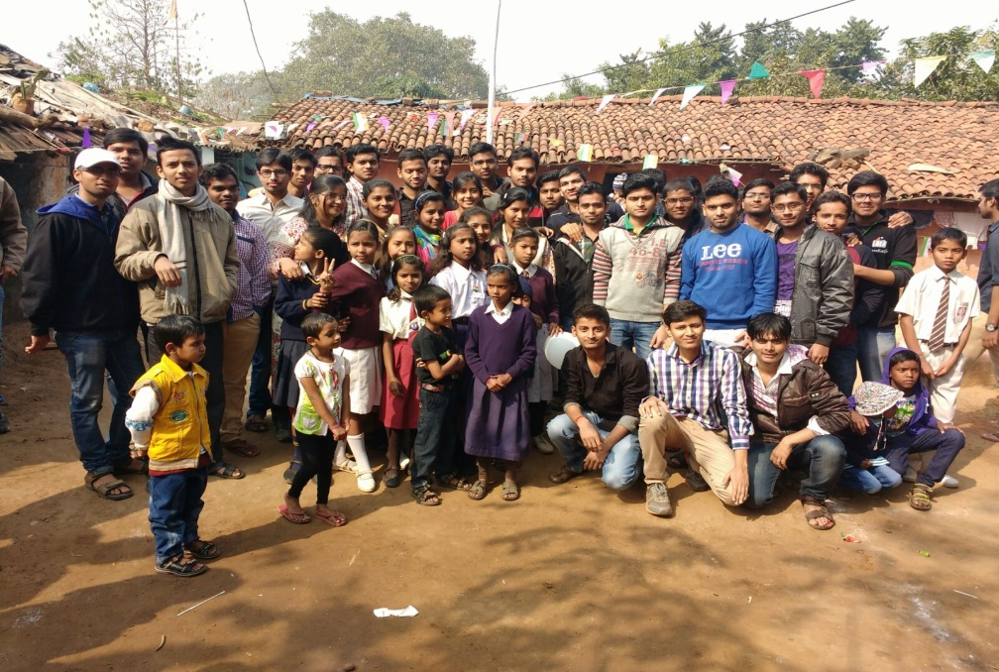
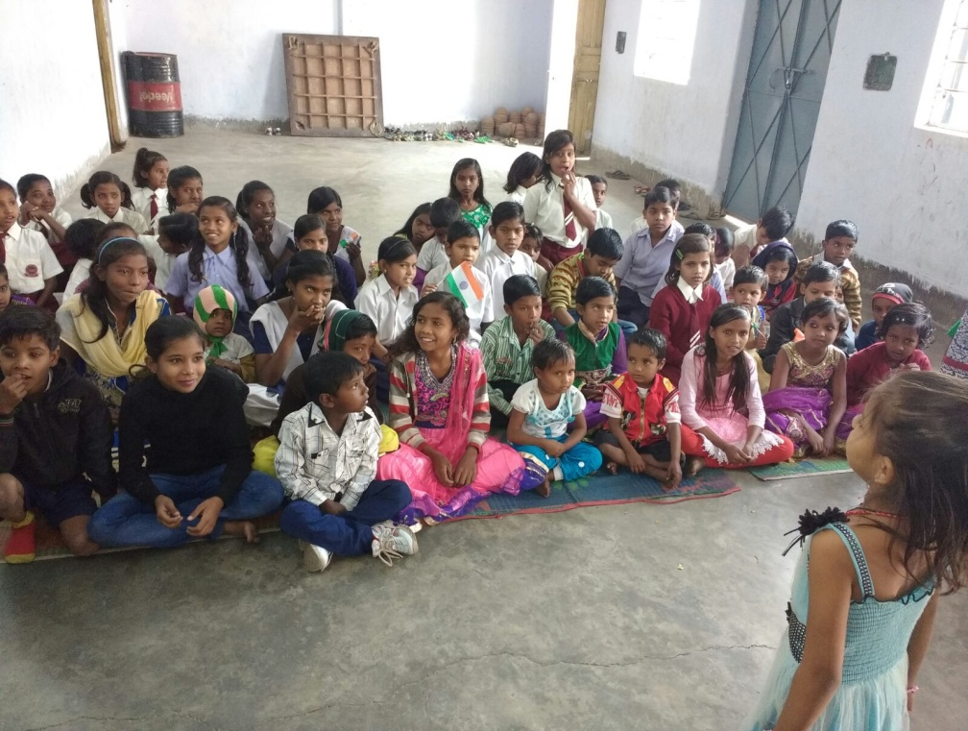
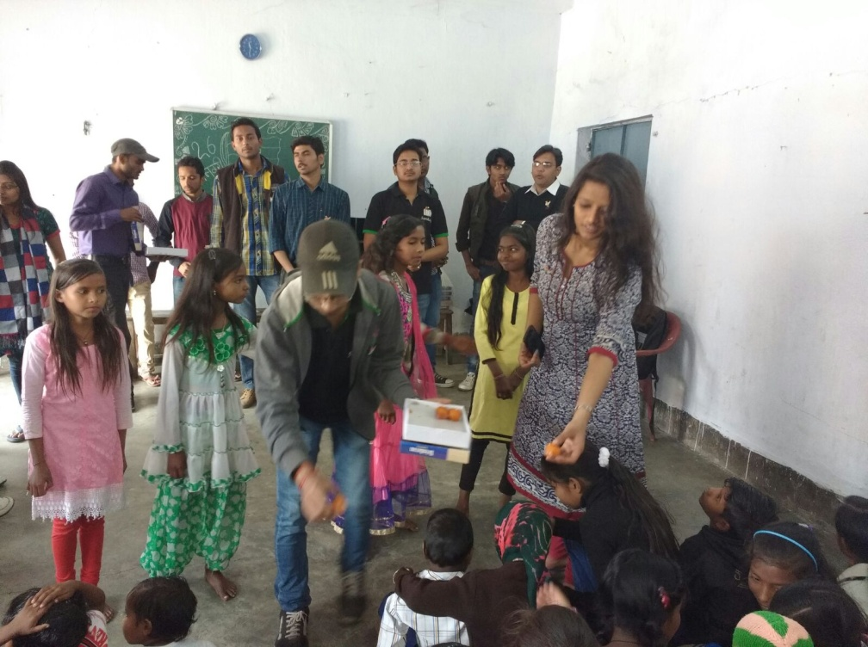

Slide 14
Launch of
Sanjeevani
Sankalp’s Common Syllabus
Curriculum

Slide 15
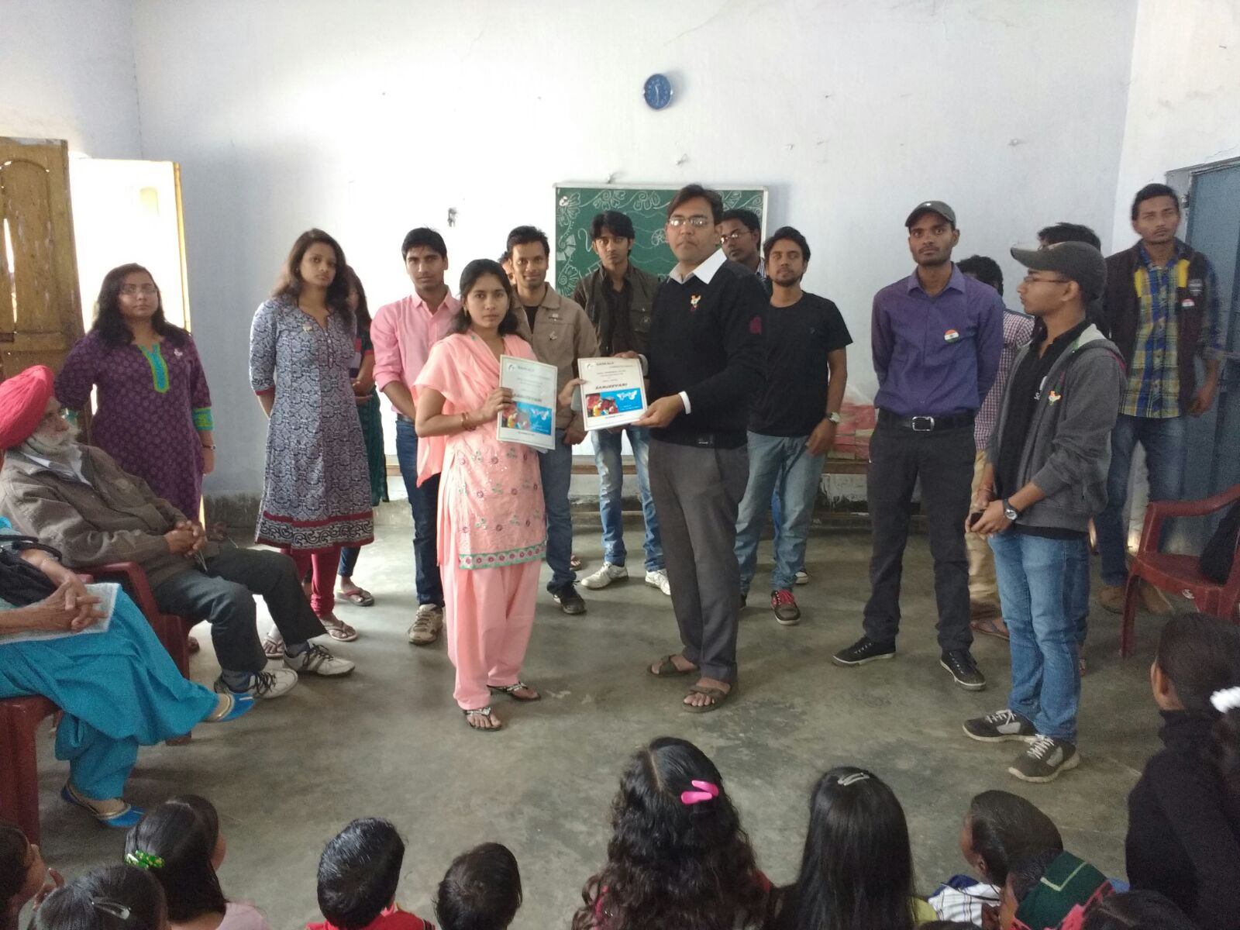

Slide 16
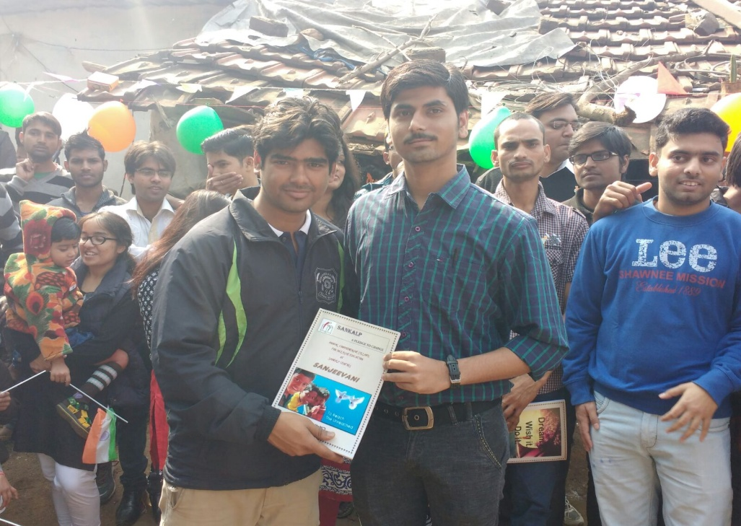
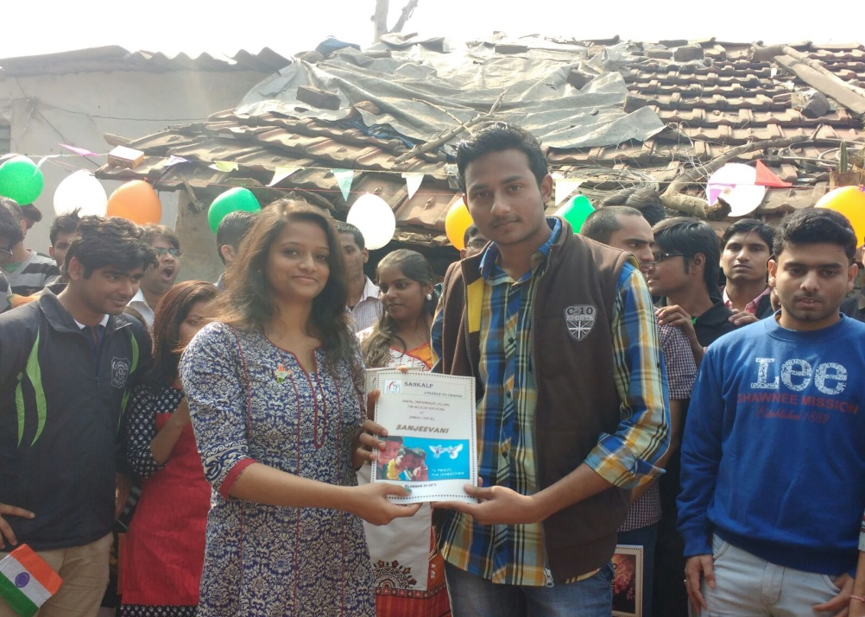
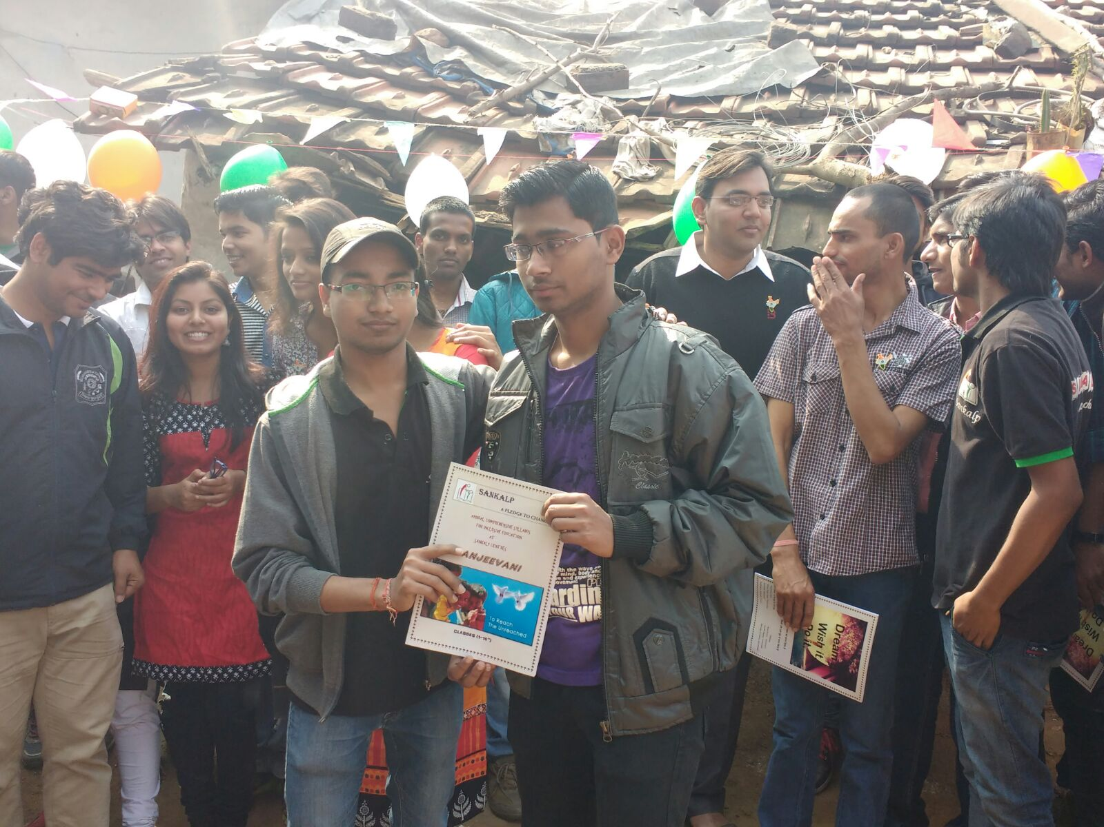
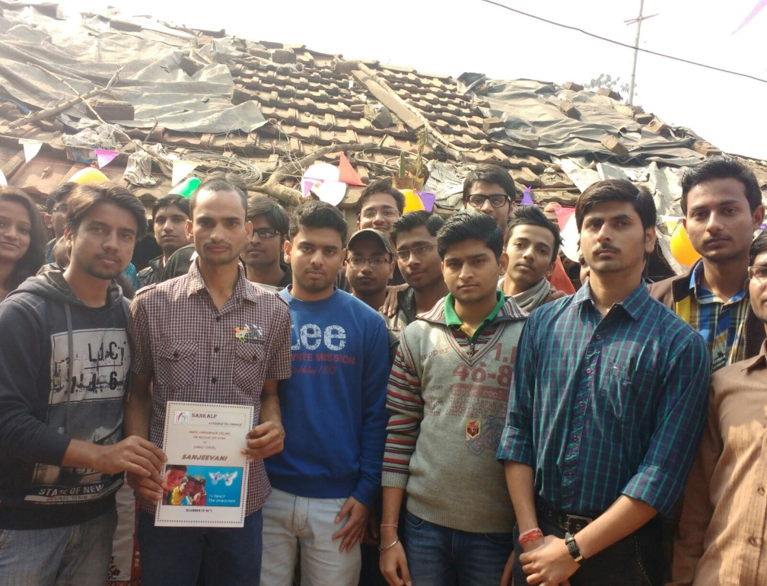

Slide 17
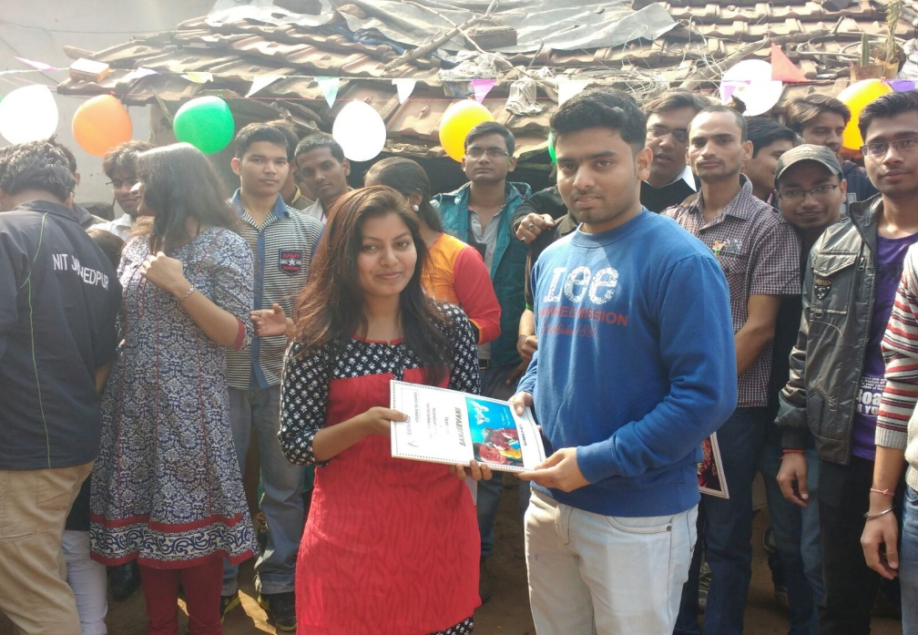
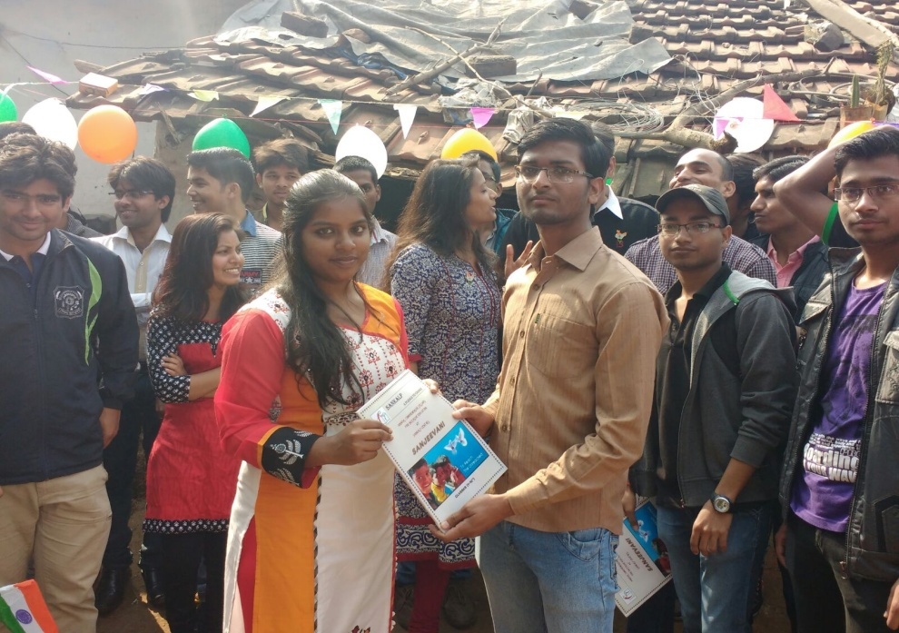
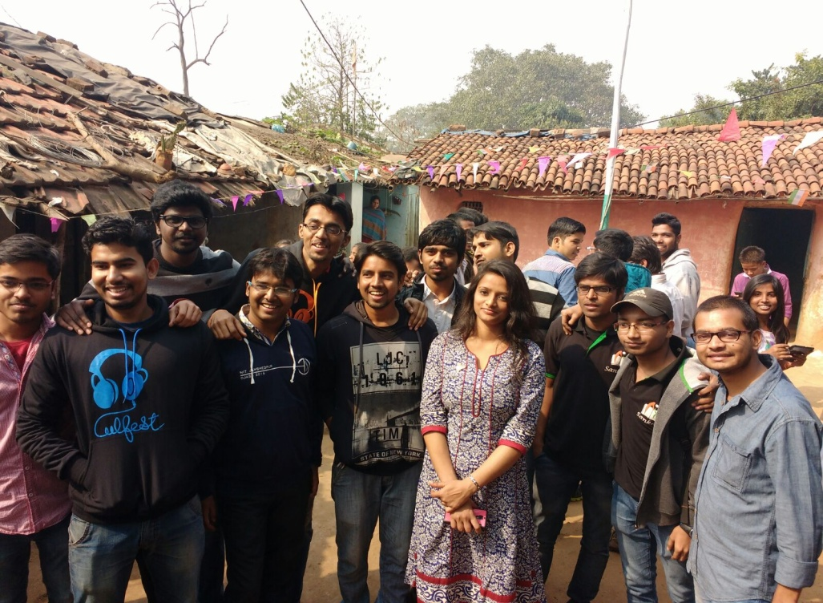
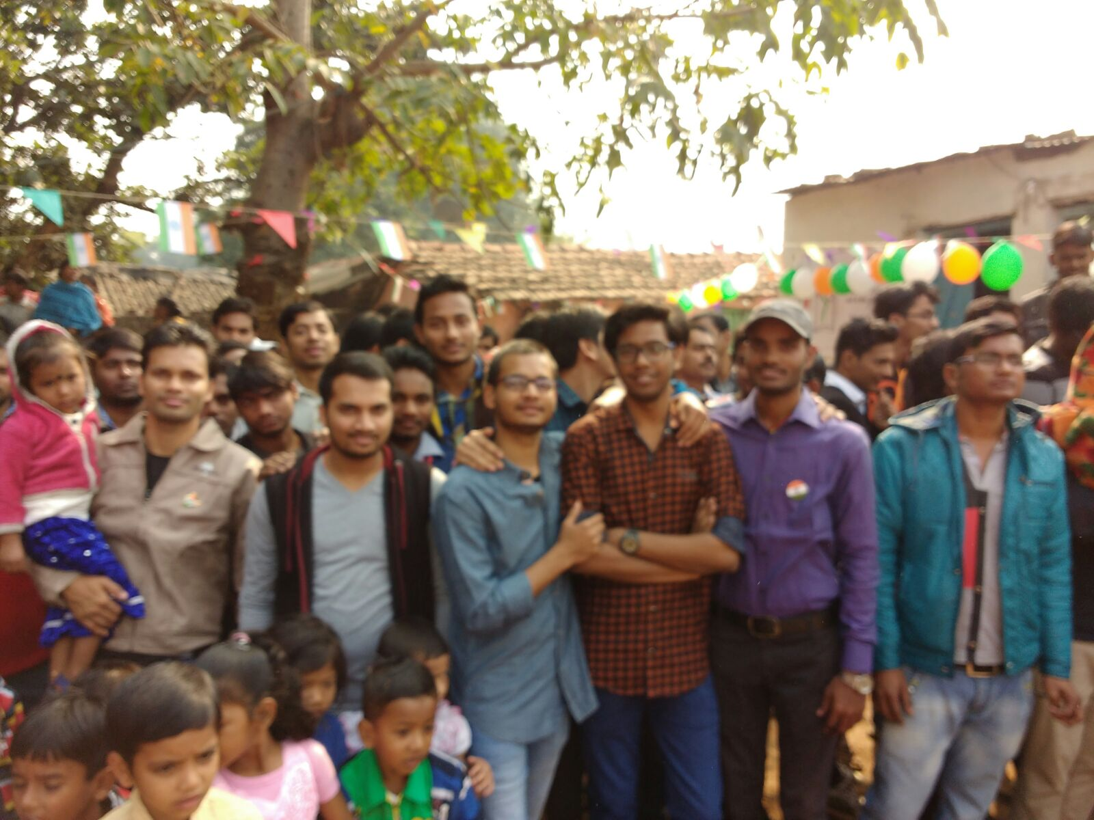

Slide 18
Sankalp Team with
Hon’ble Chief Guest
Mr. Amrit Singh

Slide 19
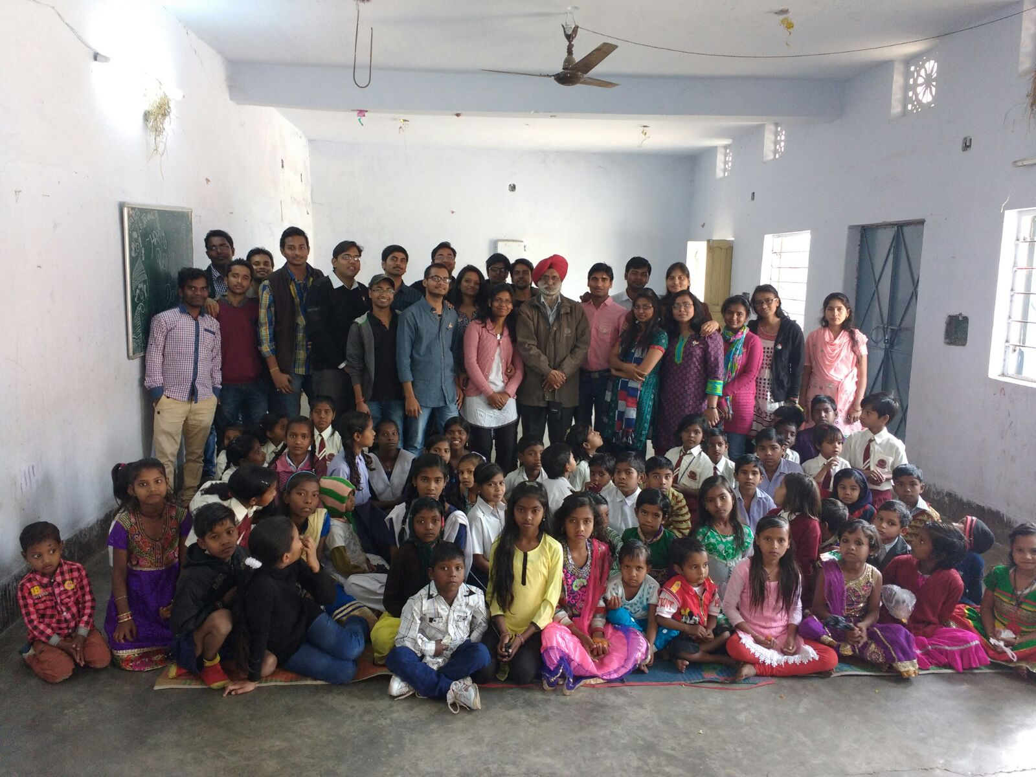

Slide 20

Into that heaven of Freedom
My Lord !!!
Let my Country awake

Slide 21
EASY WAY TO DONATE NOW
You can donate at any our centres by just making a call to Sankalp-A Pledge to Change volunteers.
All our centres run 6 days a week
You may donate books from
  Class 1-8- Course Text Books (Any Board)
  Story Books
  Unused stationery
  Any other items like bag, toys, uniforms etc.
Relevant Contact Nos. Are
  Subodh Kumar Das-9798756336
  Mayank Aggarwal -9031975746
  Suresh Pareek -7209632032
  Vikas Dixit -9472706225

Slide 22
ACCOUNT DETAILS FOR SUPPORT
Sankalp Account Details
  You can transfer funds online into our account:-
  “SANKALP” A/C No.-31114719936
  CIF No: 85757412911
  IFSC Code: SBIN0001882
  MICR Code: 831002004
  Branch code: (1882)
  Branch: SBI- RIT JAMSHEDPUR
    You may also visit our website and pay through online link available over it.
www.sankalpnitjamshedpur.org

Slide 23
“You have not lived today until you have done something for someone who can never repay you.”
Thank You
www.sankalpnitjamshedpur.org

